Slide 1
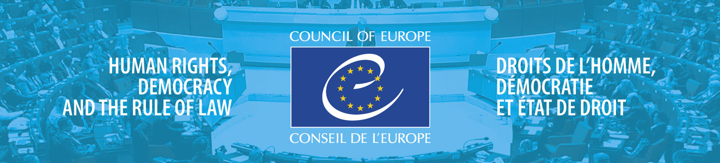

European Seniors’ Union Congress
The need for media and information literacy for all age groups –
the human rights prospective
Presentation
23-25 September 2021
Patrick Penninckx
Head of Information Society Department

Slide 2


Technology extends it’s limits

Slide 3

Emerging digital society - what is at risk?
Right to private and family life
Freedom of Expression
Right to participate in democratic processes, such as elections, free from undue influences

Slide 4





Technology connects more and more

Slide 5
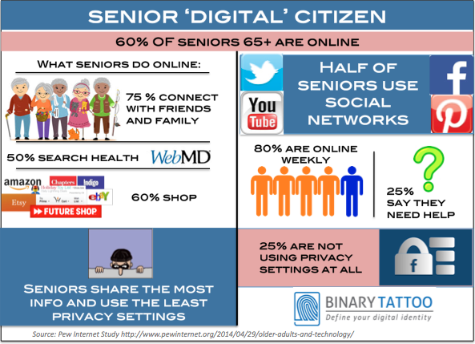
Senior ‘digital’ citizen
Notes:
Picture 1:
https://www.jayzuubar.com/post/ielts-attention-economy
From IETLS textbooks
Picture 2:
https://www.theatlantic.com/health/archive/2016/07/can-this-app-make-me-happier/490049/

Slide 6
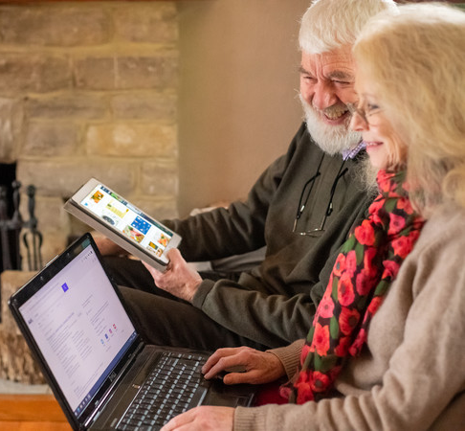
Digital developments bring opportunities…
healthcare services
smart watches (health-monitoring)
medical video-consultation
communication with the loved ones
self-driving cars
online services (travel booking, online shopping, finances planning, household expenses)
studying and access to information (kindle, podcasts)
Notes:
Picture 1:
https://www.jayzuubar.com/post/ielts-attention-economy
From IETLS textbooks
Picture 2:
https://www.theatlantic.com/health/archive/2016/07/can-this-app-make-me-happier/490049/

Slide 7
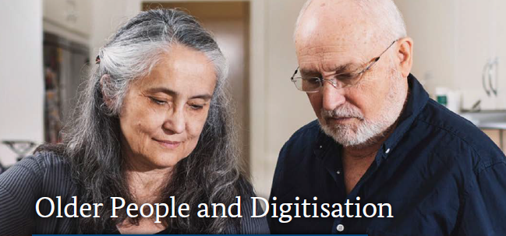

Impact on six areas of life
Adapting Housing
Maintaining Mobility
Supporting Socialisation
Improving Healthcare
Supporting Nursing Care
Access to Public Space
Findings and recommendations from the Eighth Government Report on Older People
Source: bmfsfj.de
7

Slide 8
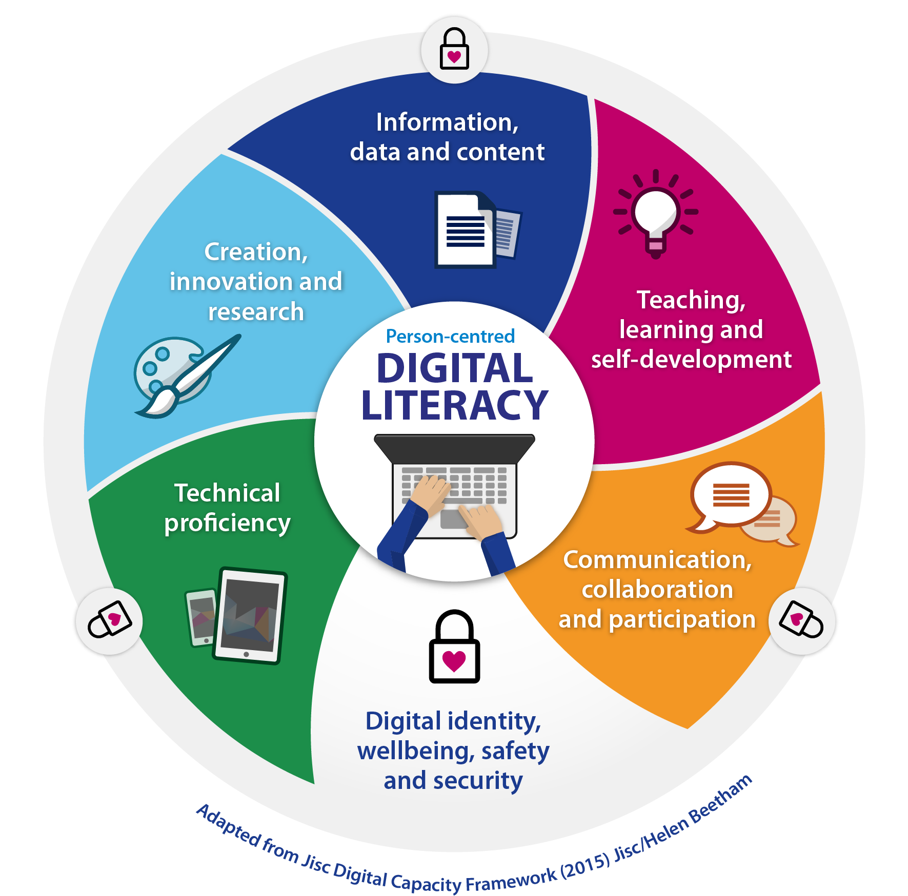
Rights of seniors in the digital world
Recommendations by the Committee of Ministers
Internet freedom
The right to private life with regard to network neutrality
Guide to Human Rights for Internet Users
Studies
Algorithms and Human Rights
Internet and Electoral Campaigns
Spaces of Inclusion
Media Literacy for All

Slide 9
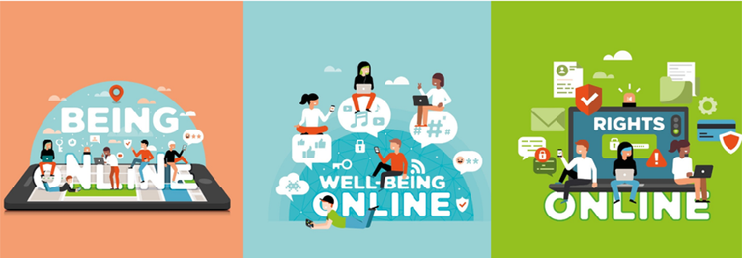
Digital citizenship education
The aim of the Digital Citizenship Education is the empowerment through education and the acquisition of competences for learning and active participation in digital society.
Source: www.coe.int/digital citizenship

Slide 10
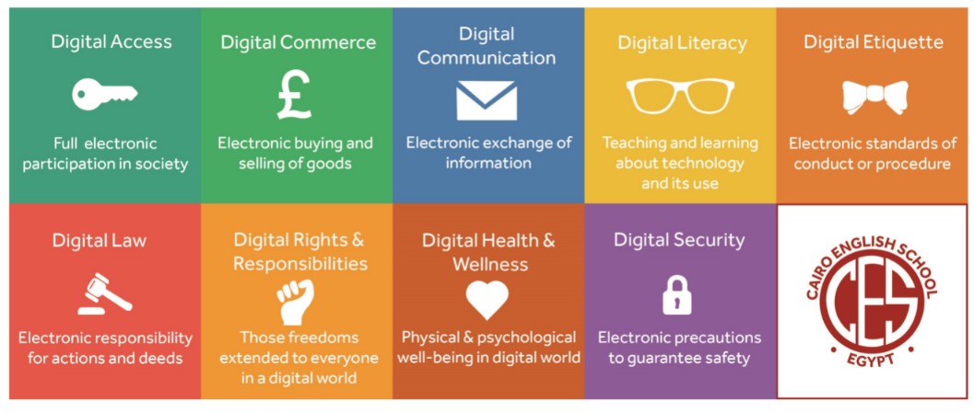
Media Literacy
Digital citizenship for all
Source: digitalcitizenship.net

Slide 11

Media literacy and human rights
Media and Information Literacy lies at the core of freedom of expression and information.
It evolves in response to changing technological, social, cultural, and political factors.
As a result, it should be viewed as a life-long individual learning journey, requiring regular updating of skills and knowledge.

Slide 12

Media literacy and human rights
Media literacy enables individuals to develop cognitive, technical and social skills to:
effectively access and critically analyse media content;
make informed decisions about which media they use and how to use them;
understand the ethical implications of media and new technologies;
communicate effectively, including by creating content.

Slide 13

Media literacy and human rights
Media literacy also contributes to media pluralism and diversity:
by reducing the digital divide;
by facilitating informed decision making (especially as regards political and public affairs and the free choice of the electorate in a free and fair election of their representatives);
by enabling the identification and countering false and/or misleading information and illegal online content.

Slide 14
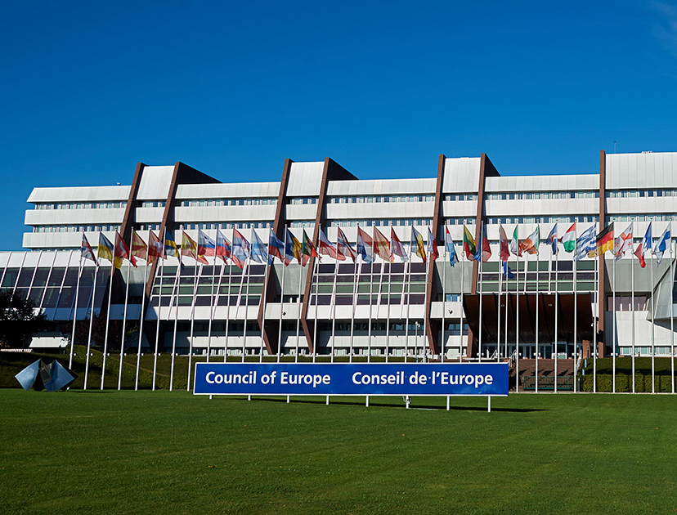
Media literacy and human rights
The Council of Europe has taken a two-fold approach to media literacy:
the first objective is to set media literacy within institutional frameworks;
the second objective is to provide tools for empowering individual media users of all ages and walks of life.

Slide 15

Addressing the needs of seniors
Over 65s are at risk of being under-served by media literacy initiatives.
A significant obstacle to reaching an older audience with media literacy tools and training may be the absence of dissemination networks (such as schools are for younger people).
A large majority of projects target either teachers or school children. Only 25 of the 65 projects analysed included aged 65+ as one of their target groups.
Projects targeting older people tend to be of a strategic nature such as policy, rather than bespoke projects or resources targeting this group. As a result, there appears to be a lack of media literacy training and tools aimed at older people.
Source: the study “Supporting Quality Journalism through Media and Information Literacy”

Slide 16

Addressing the needs of seniors
Over 65s are at risk of being under-served
by media literacy initiatives.
The data appears to suggest that there is a risk that while teachers and students are being well-served, group of people most likely to share disinformation online and least likely to be familiar with how the economics and the online infrastructure operates (over 65s) are the being under-served by these projects.
Source: the study “Supporting Quality Journalism through Media and Information Literacy”

Slide 17

Addressing the needs of seniors
Over 65s are at risk of being under-served
by media literacy initiatives.
There is a need for more of so-called “public-facing” media literacy programmes and activities, those that bring MIL to the general public, e.g. public information campaigns, national training programmes or community media programmes. Many such programmes rely on voluntary effort and would benefit greatly from a more systematic public funding.
Source: the study “Supporting Quality Journalism through Media and Information Literacy”

Slide 18

Addressing the needs of seniors
Ministerial Conference on Artificial Intelligence-Intelligent politics, Challenges and opportunities for media and democracy of 10-11 June 2021:
Ministers responsible for media and information society met to discuss and decide how to address the profound changes in the media and information environment brought on by the process of digitalisation.
Through the adoption of a number of instruments, the CoE member states committed to enhance and protect the human rights in a new media landscape where people have access, use and understand the new media and digital technologies, think critically, analyse it and make informed choices.

Slide 19

Information Society Department
Thanks for your attention !
further resources:
www.coe.int/freedomofexpression
www.coe.int/internetgovernance
www.coe.int/dataprotection
www.coe.int/cybercrime
www.coe.int/AI
Facebook Page
Information Society Group

Slide 20
