Slide 1
ESU: a quarter of a century of active citizenship in a period of turbulent European unification
ESU Congress Madrid │24 September 2021
Prof. Steven Van Hecke
@VanHeckeSteven

Slide 2
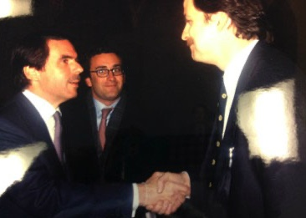

From Madrid (1995) to Madrid
A picture is worth a thousand words
Notes:
Personalities, persons and people

Slide 3
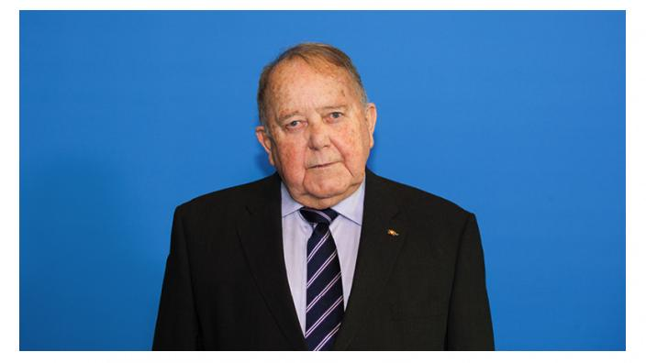
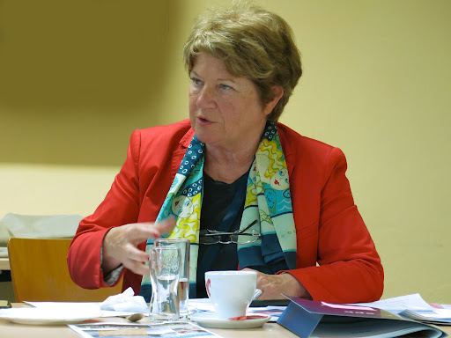
Persons (leadership)
Notes:
stability

Slide 4
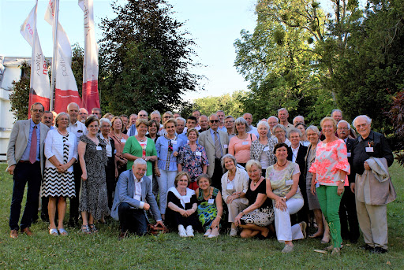
People (engagement)

Slide 5
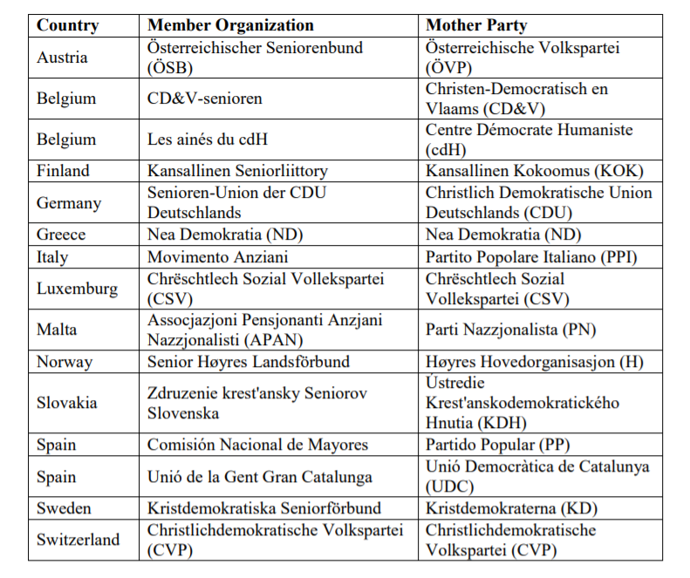

Slide 6

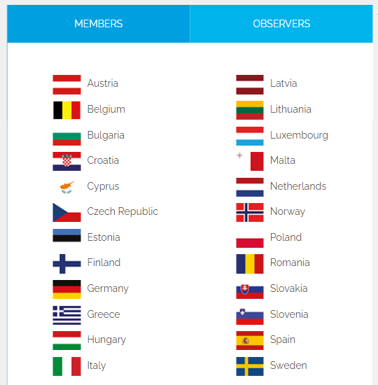

Slide 7
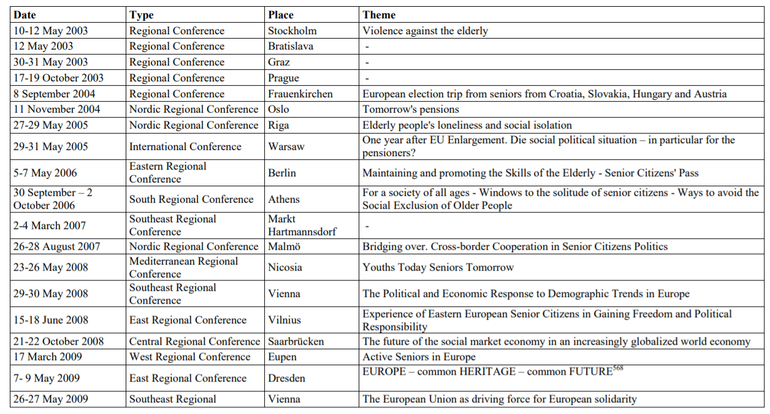
Policies (topics)

Slide 8
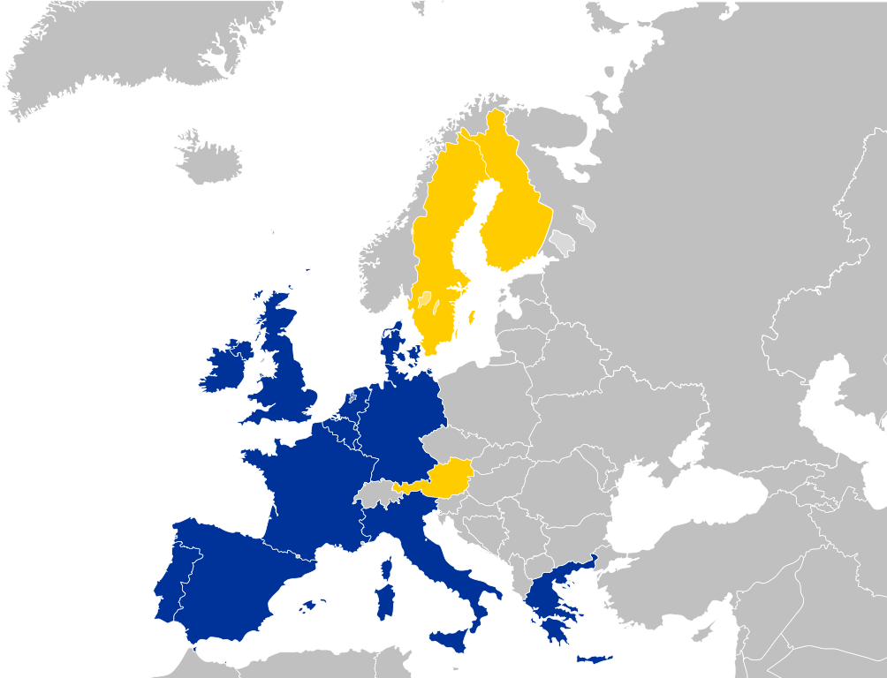
1995

Slide 9
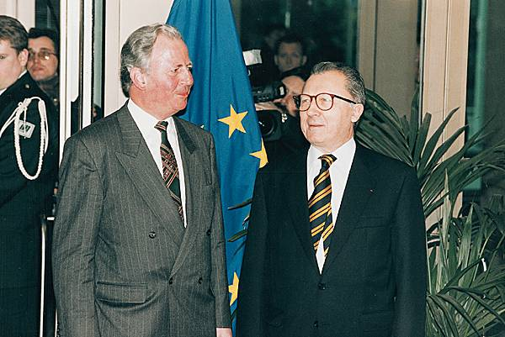
1995

Slide 10
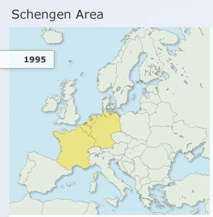

Slide 11
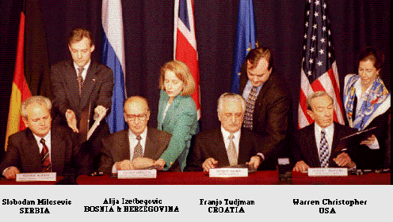
1995

Slide 12

1995
Romania, Slovakia, Latvia, Lithunania, Estonia and Bulgaria formally apply for accession to the EU.

Slide 13
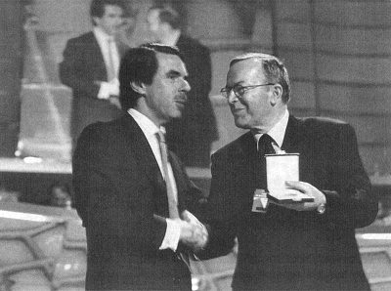

EPP Congress Madrid

Slide 14
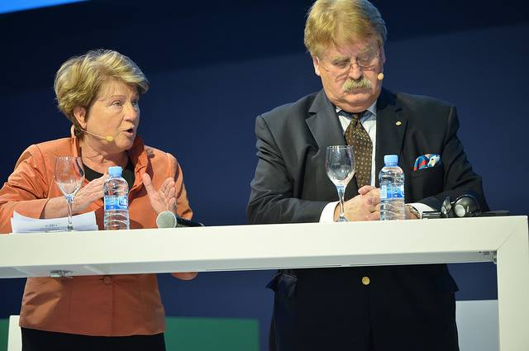
Representation within the EPP

Slide 15
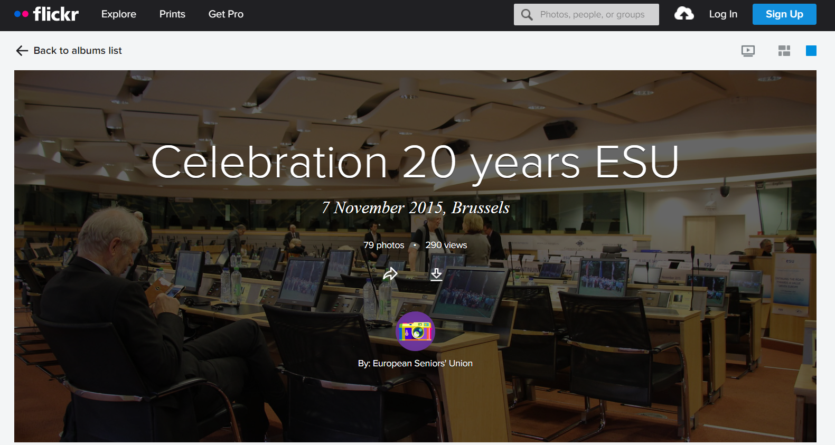

Slide 16


1995-2025

